Slide 1
Introduction to Machine Learning
Monday, Lecture 1
FASE ML Bootcamp
Based on material from Polo Chau, Tom Mitchell, Roni Rosenfeld, Martial Hebert, Hal Daumé III, David Sontag

Slide 2
A bit about myself…
ekhalil.com
Joining UofT MIE starting July 2020!
IVADO Postdoc at Polytechnique Montreal
PhD in Computational Science & Engineering, 2019
Research Interests
Machine Learning for Discrete Optimization and Operations Research
Principled Optimization Methods for ML
Climate Change & Sustainability applications
Canada Excellence Chair in Data Science for Real-Time Decision-Making

Slide 3
Teaching Assistants
Kyle Booth
http://kylebooth.org/
Final year IE PhD student
Research in AI and OR for mobile robotics and energy-constrained vehicle routing
Alex Olson
2nd Year MIE MASc Student
Collaborating with researchers in Urban Studies on developing new representations of neighbourhood change

Slide 4

Artificial Intelligence
Getting computers to behave intelligently:
Perform non-trivial tasks as well as humans do
Perform tasks that even humans struggle with
Many sub-goals:
Perception
Reasoning
Control
Planning
Notes:
Roni Rosenfeld ML Intro: https://www.cs.cmu.edu/~roni/10601/presentations/ML%20Intro.pptx

Slide 5
Speech Recognition
Perception + Reasoning
https://medium.com/@joelgarciajr84/creating-an-application-that-uses-speech-recognition-76117a396b7d

Slide 6
Autonomous Driving
Perception + Reasoning
Control + Planning
https://www.pymnts.com/news/partnerships-acquisitions/2019/ups-invests-in-autonomous-driving-firm-tusimple/

Slide 7
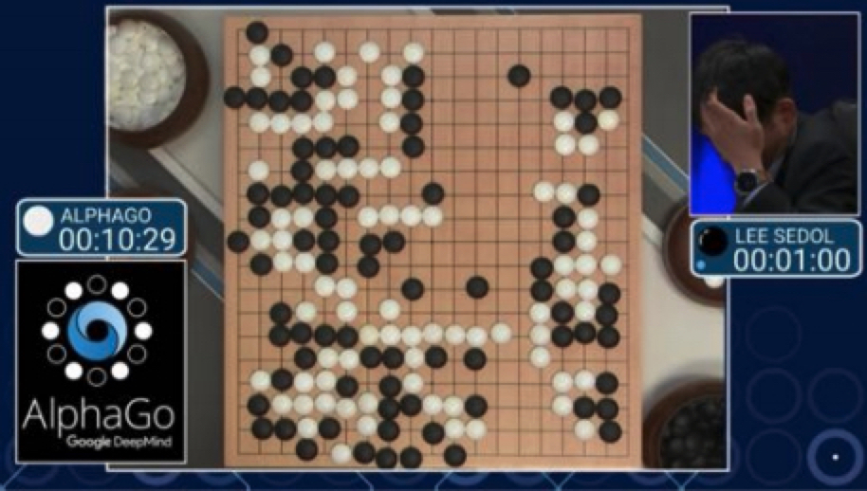
Game Playing
Reasoning + Planning
https://www.digitaltrends.com/computing/texas-holdem-libratus-ai-defeats-humans/

Slide 8
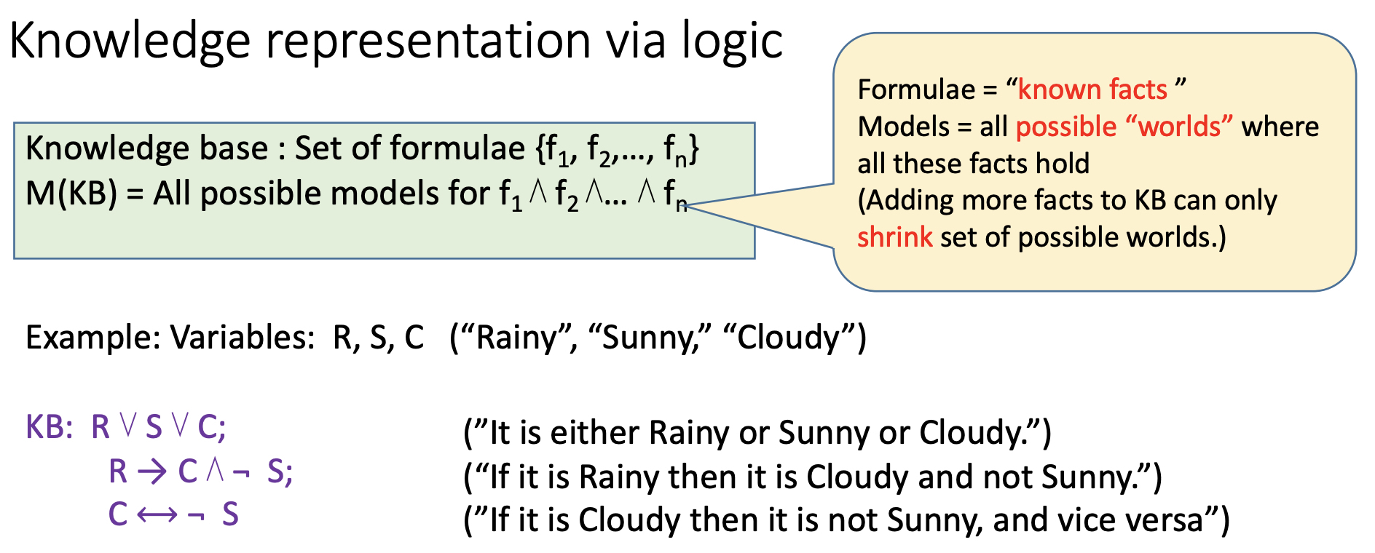
Knowledge-Based AI
Write programs that simulate how people solve the problem
Fundamental limitations:
Will never get better than a person
Requires deep domain knowledge
We don’t know how we do some things (e.g., riding a bicycle)
Based on slide by Arora and Hazan at Princeton

Slide 9
Data-Based AI = Machine Learning
Write programs that learn the task from examples
✅ No need to know how we do it as humans
✅ Performance should improve with more examples
❌ May need many examples!
❌ May not understand how the program works!

Slide 10
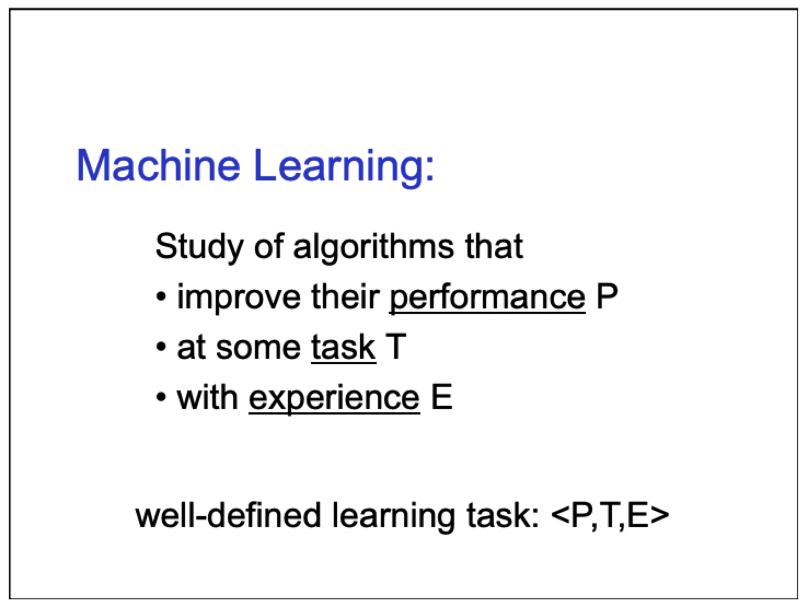
Tom Mitchell, CMU 10-601 slides

Slide 11
The Machine Learning Process
Experience
Examples of the form
(input, correct output)
Task
Mapping from input to output
Performance
”Loss function” that measures error w.r.t. desired outcome
Tom Mitchell, CMU 10-601 slides

Slide 12
Choices in ML Problem Formulation
Loan Applications
Experience
Examples of the form
(input, correct output)
Task
Mapping from input to output
Performance
”Loss function” that measures error w.r.t. desired outcome
What historical examples do I have? What is a correct output?
Predict probability of default? Loan decision? Credit score?
Do I care more about minimizing False Positives? False negatives?

Slide 13
This course
The main algorithms (models)
Focus on Deep Neural Networks
Evaluation
Optimization
Classification
Regression
Clustering
Tabular
Image
Sequence
Notes:
Common ML models, principles and how to apply them

Slide 14
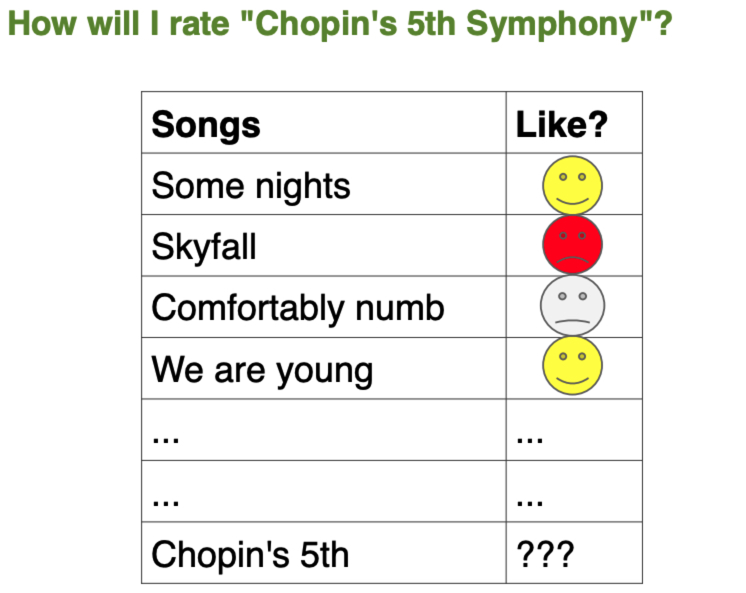
Polo Chau, Georgia Tech CSE 6242

Slide 15
Classification: Three Elements
Data: S = {(x_{i}, y_{i})}_{i = 1,…,n}
x_{i}: data example with d attributes
y_{i}: label of example (what you care about)
Classification model: a function f_{(a,b,c,…)}
Maps from X to Y
(a,b,c,…) are the parameters
Loss function: L(y, f(x))
Penalizes the model’s mistakes
Polo Chau, Georgia Tech CSE 6242

Slide 16
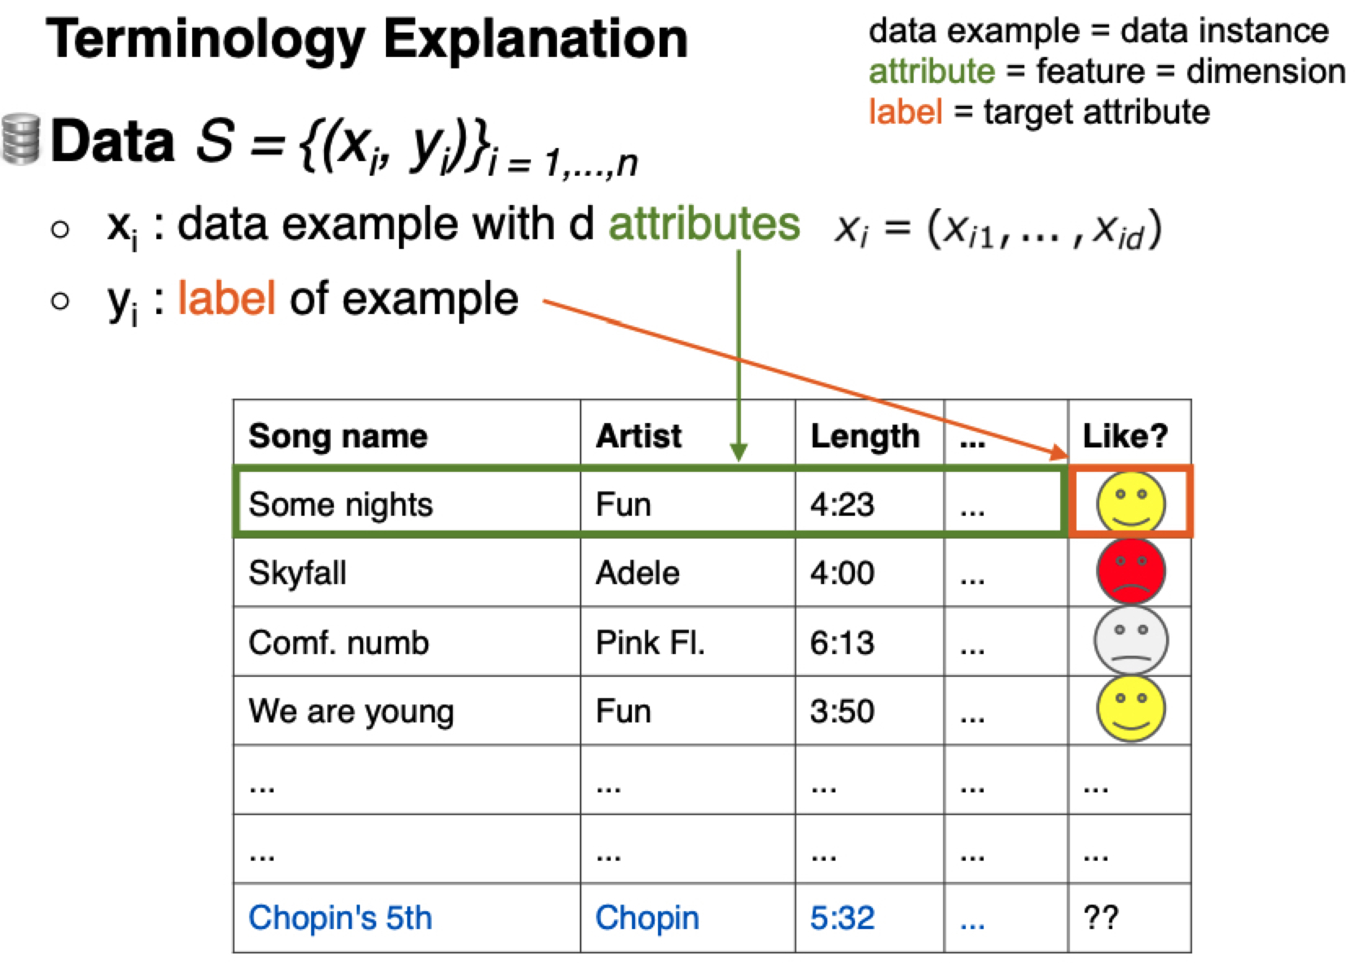
Polo Chau
Georgia Tech CSE 6242

Slide 17
What is a “model”?
y
A useful approximation of the world
Typically, there are many reasonable models for the same data
Training a model = finding appropriate values for (a,b,c,…)
An optimization problem
“appropriate” = minimizes the Loss function
We will focus on a common training algorithm later on
x

Slide 18
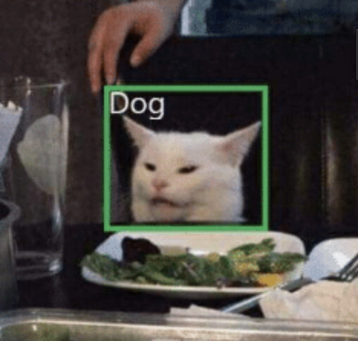
Classification Loss Function
How unhappy you would be if your model f(.) predict label y’ on input x when y is the correct output
L₀₋₁(y, f(x)) = 1 if: y ≠ f(x)
0 otherwise
0-1 loss function: intuitive but hard to optimize = train
In practice, we use approximations of the 0-1 loss

Slide 19
Why should this work at all?
The main theoretical basis of ML:
With a sufficient amount of “similar” data
+
an expressive model class:
Minimizing the loss function on the training data yields a highly accurate model on unseen test data, with high probability
Data: S = {(x_{i}, y_{i})}_{i = 1,…,n}
x_{i}: data example with d attributes
y_{i}: label of example (what you care about)
Classification model: a function f_{(a,b,c,…)}
Maps from X to Y
(a,b,c,…) are the parameters
Loss function: L(y, f(x))
Penalizes the model’s mistakes

Slide 20
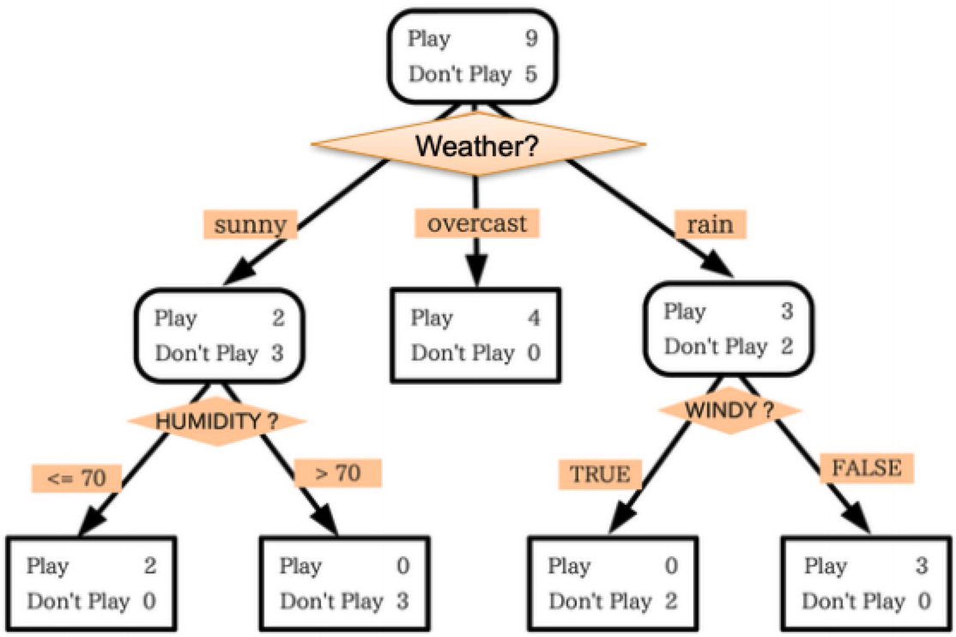
Decision Trees: To play tennis or not to?
Data: attributes describing the weather; (sunny? humidity level, …)
Target: 1 if it’s good to Play, 0 otherwise
Model: f_{T}(x)
Model parameters: T, the tree structure (and size)

Slide 21
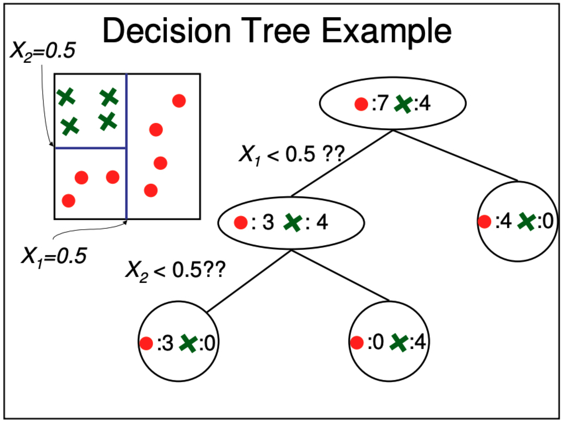
Martial Hebert, CMU 15-381
Notes:
http://www.cs.cmu.edu/afs/cs.cmu.edu/academic/class/15381-s06/www/DTs.pdf

Slide 22
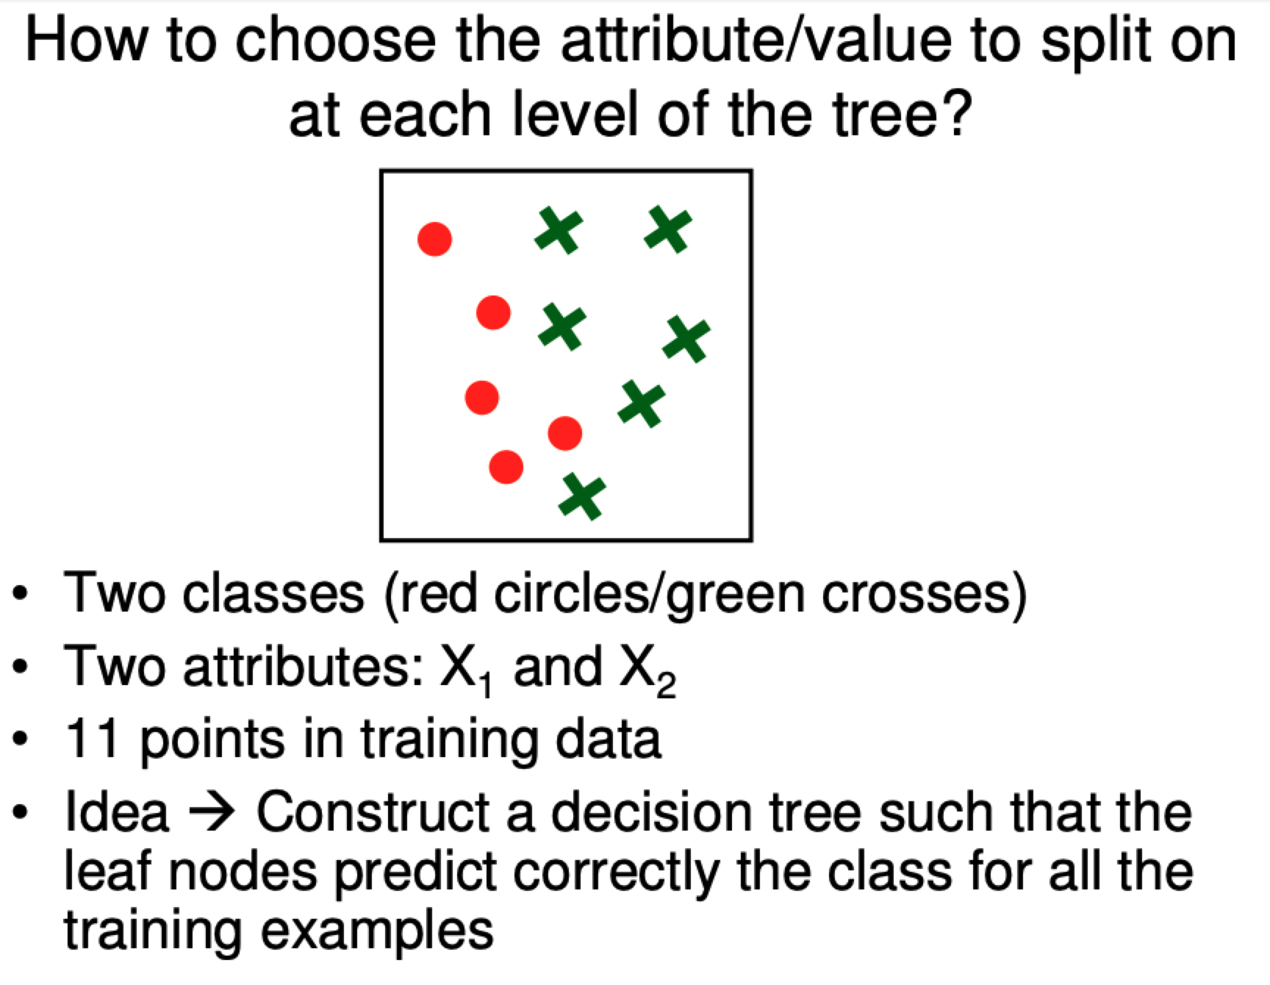
Training (fitting) a Decision Tree
Martial Hebert, CMU 15-381
Notes:
http://www.cs.cmu.edu/afs/cs.cmu.edu/academic/class/15381-s06/www/DTs.pdf

Slide 23
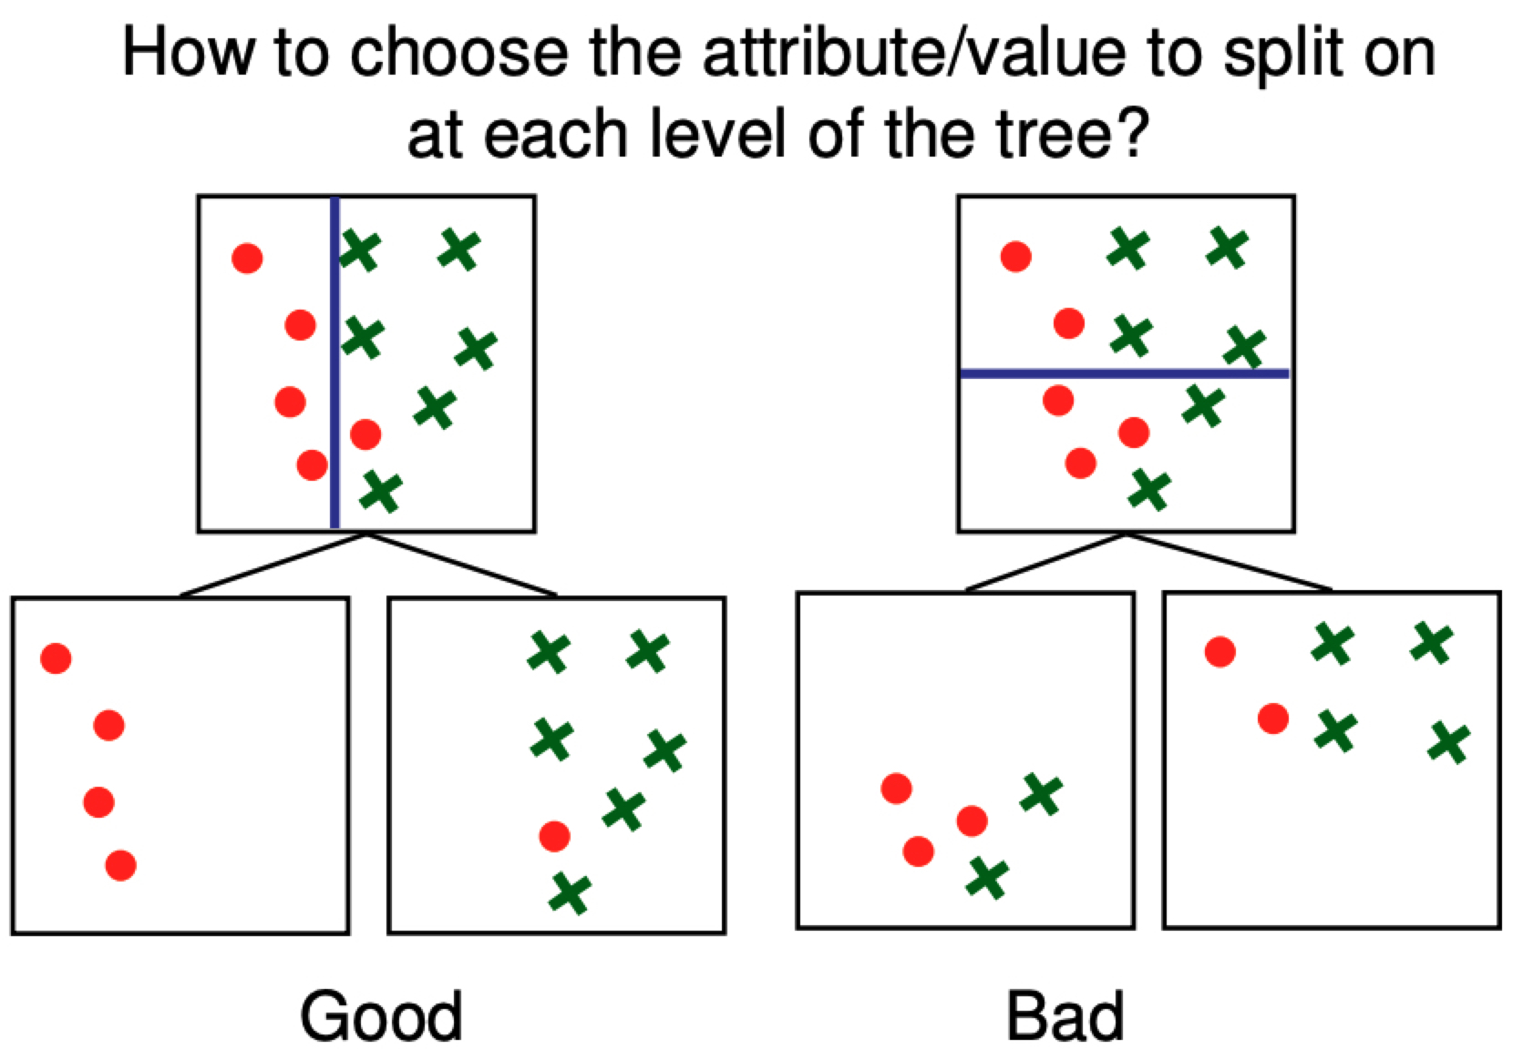
Training (fitting) a Decision Tree
These splits are great because the nodes are “pure”
These splits are bad because the nodes have a mix of samples
Martial Hebert, CMU 15-381
Notes:
http://www.cs.cmu.edu/afs/cs.cmu.edu/academic/class/15381-s06/www/DTs.pdf

Slide 24
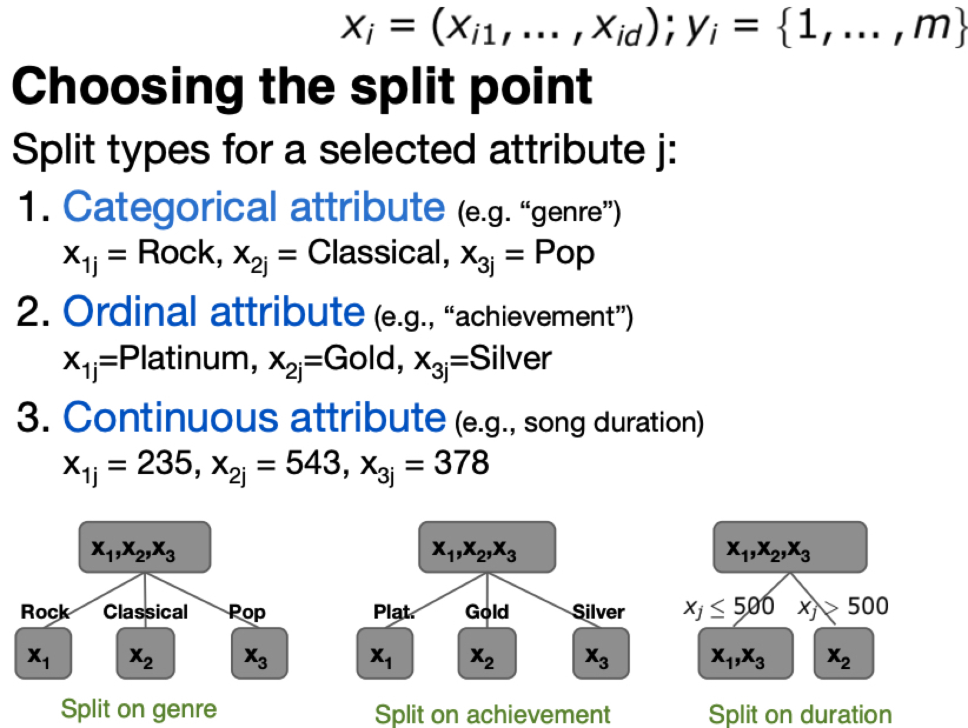
Polo Chau, Georgia Tech CSE 6242

Slide 25
Training (=fitting) a Decision Tree
Find the best attribute to split on
Find the best split on the chosen attribute
Repeat 1 & 2 until stopping criterion is met
Common stopping criteria:
Node contains very few data points
Node is pure: most training data in node have same label

Slide 26
Final words on Decision Trees
Advantages
Simple interpretation
Fast predictions
Handles mixed-type attributes
Caveats
May be too simple for complex data
Hard to figure out the right depth, stopping criterion, especially at the node level

Slide 27
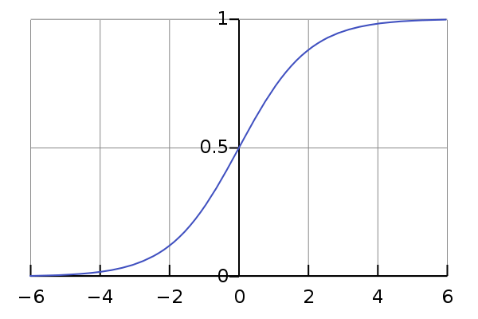
Logistic Regression (LR)
σ(x) = 1/(1 + e^{-x})
Decision Trees predict discrete outcomes
LR predicts probabilities of outcomes
Probabilities give a notion of certainty
Model can still be used as a classifier
Probability of getting cervical cancer, p(x):
p(age=42, #pregnancies=3, smoking=True, …)
Notes:
https://christophm.github.io/interpretable-ml-book/logistic.html
https://www.stat.cmu.edu/~cshalizi/uADA/12/lectures/ch12.pdf

Slide 28
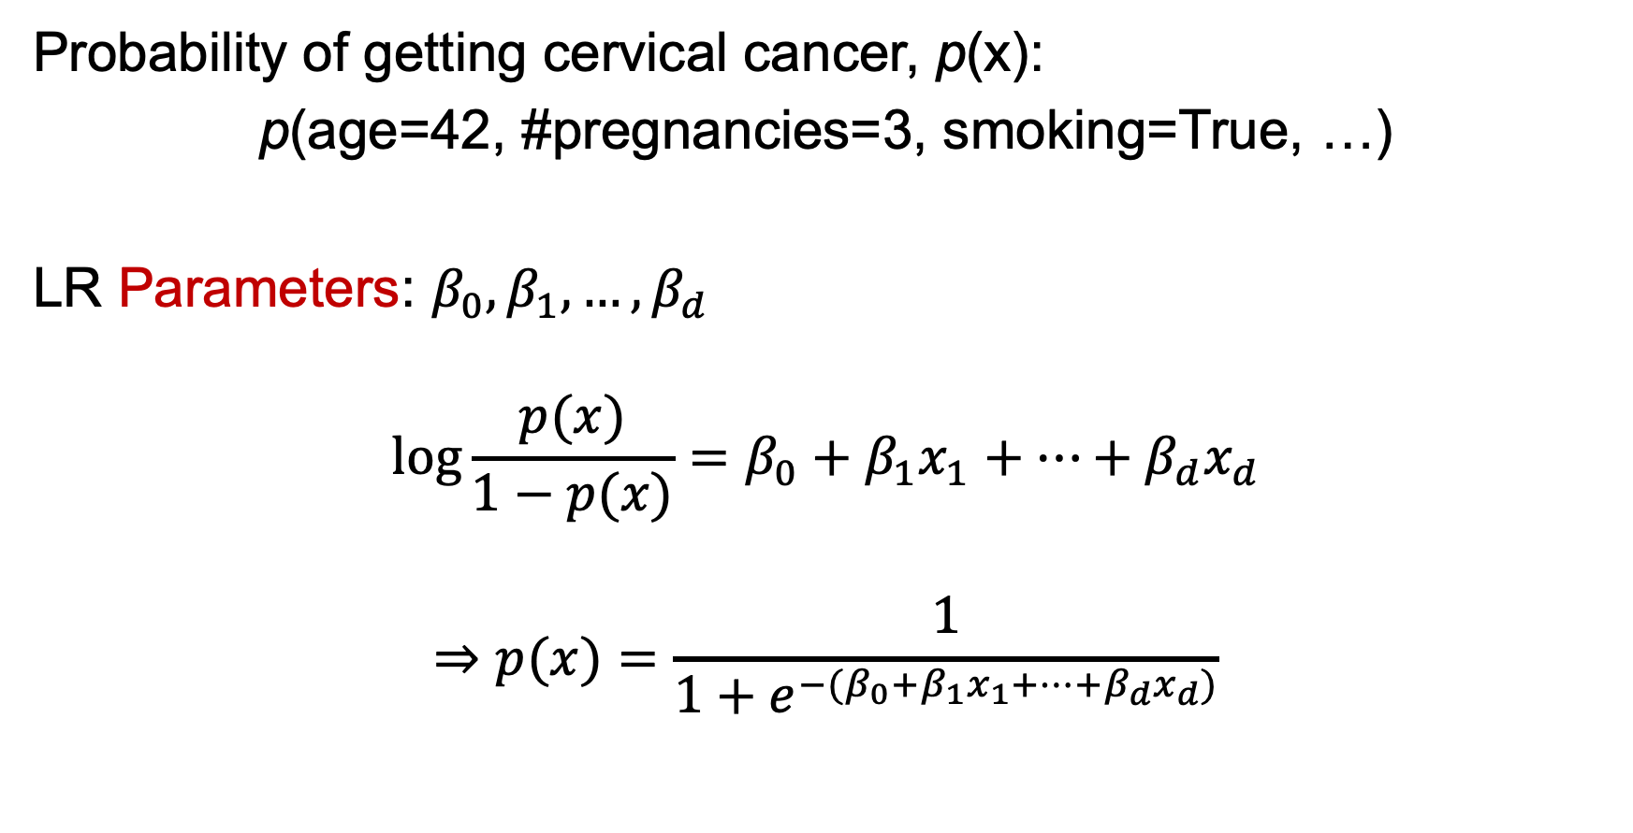
Logistic Regression: Assumptions
Probability of getting cervical cancer, p(x):
p(age=42, #pregnancies=3, smoking=True, …)
LR Parameters: $β_{0}, β_{1},…, β_{d}$
$$\log{\frac{p(x)}{1−p(x)}}=β_{0}+β_{1}x_{1}+…+β_{d}x_{d}$$
$$⇒p(x)=\frac{1}{1+e^{−(β_{0}+β_{1}x_{1}+…+β_{d}x_{d})}}$$
This is the model!
Notes:
https://christophm.github.io/interpretable-ml-book/logistic.html

Slide 29
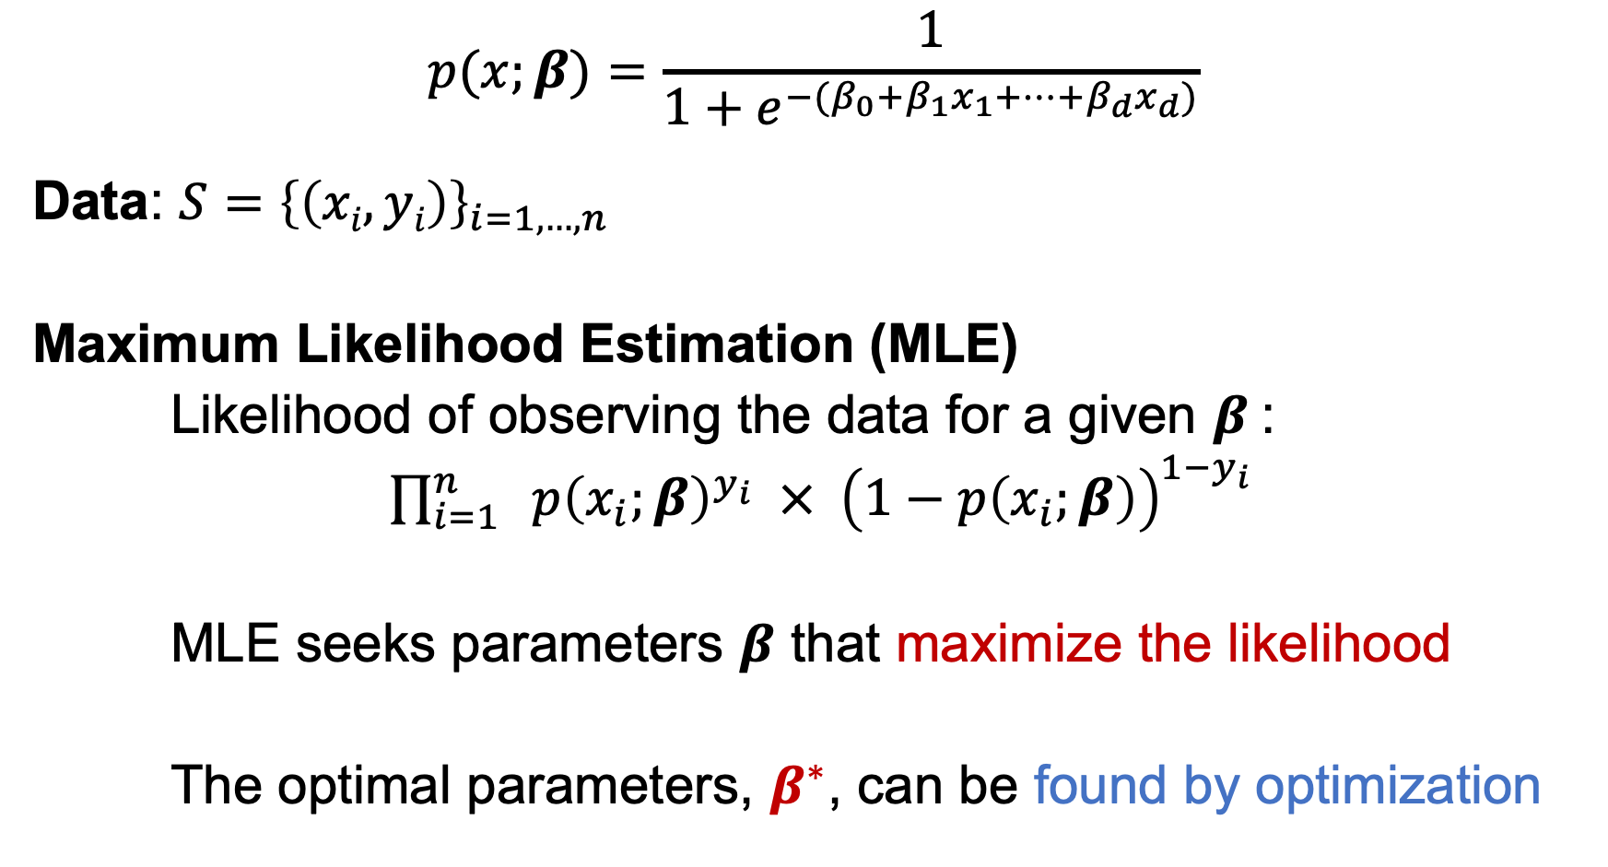
Logistic Regression: Training
$$p(x;β)=\frac{1}{1+e^{−(β_{0}+β_{1}x_{1}+…+β_{d}x_{d})}}$$
Data: $S={\left\{\left(xi, yi\right)\right\}}_{i=1,…, n}$
Maximum Likelihood Estimation (MLE)
Likelihood of observing the data for a given $β$:
$\prod_{i=1}^{n}{ p{\left(x_{i};β\right)}^{y_{i}} × {\left(1−p\left(x_{i};β\right)\right)}^{1−y_{i}}}$
MLE seeks parameters $β$ that maximize the likelihood
The optimal parameters, $β^{∗}$, can be found by optimization
x_{i}: example with d attributes (age, #pregnancies, …)
y_{i}: cervical cancer diagnosis (0 or 1)
Notes:
https://christophm.github.io/interpretable-ml-book/logistic.html

Slide 30
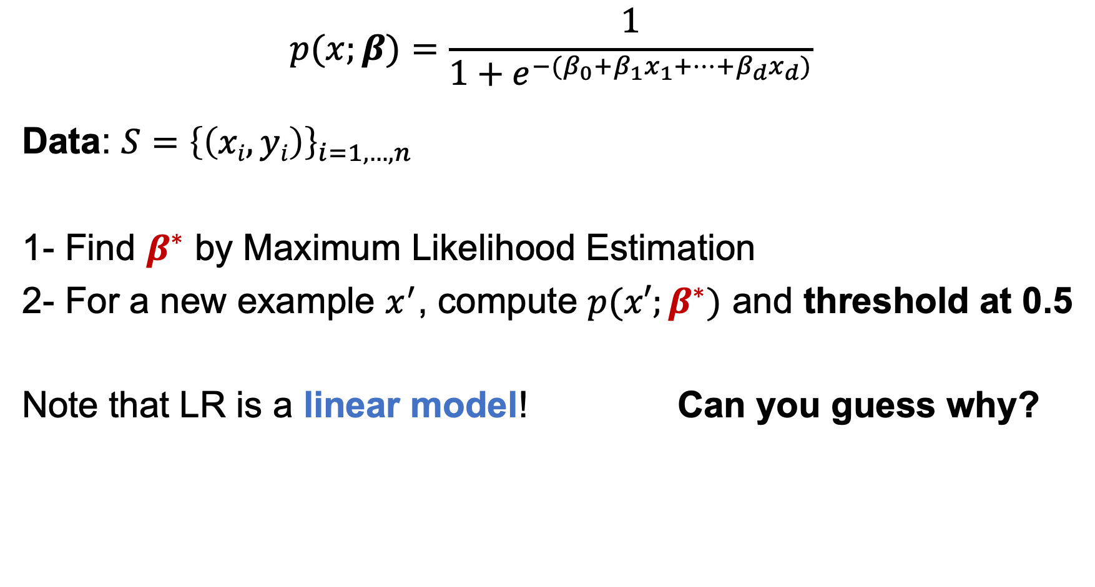
Logistic Regression: Properties
$$p(x;β)=\frac{1}{1+e^{−(β_{0}+β_{1}x_{1}+…+β_{d}x_{d})}}$$
Data: $S={\left\{\left(xi, yi\right)\right\}}_{i=1,…, n}$
1- Find $β^{∗}$ by Maximum Likelihood Estimation
2- For a new example $x^{′}$, compute $p(x′;β^{∗})$ and threshold at 0.5
Note that LR is a linear model! Can you guess why?
x_{i}: example with d attributes (age, #pregnancies, …)
y_{i}: cervical cancer diagnosis (0 or 1)
Notes:
https://christophm.github.io/interpretable-ml-book/logistic.html

Slide 31
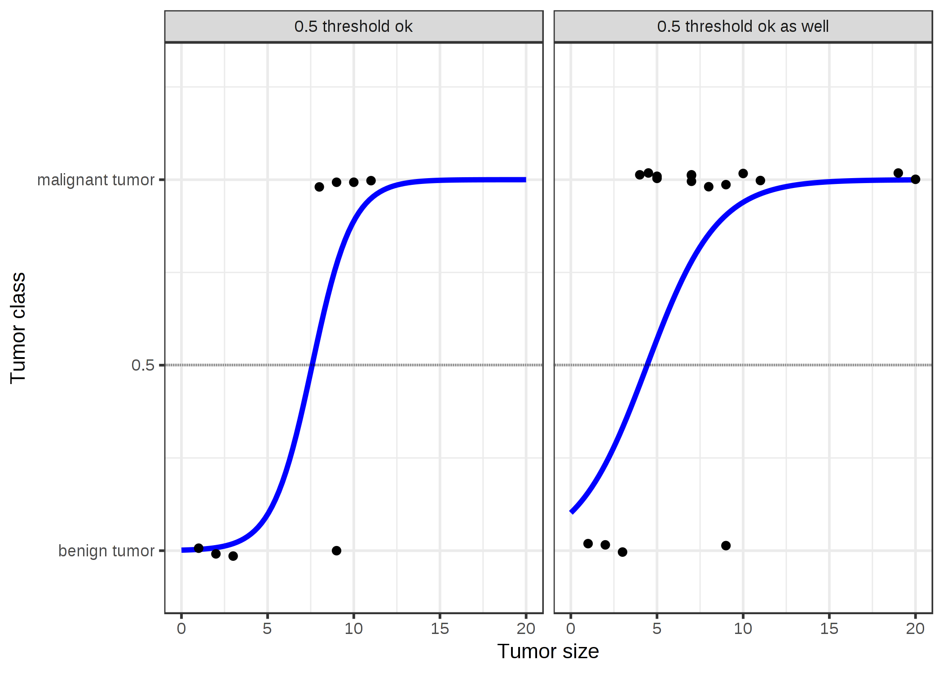
Final words on Logistic Regression
Advantages
Simple interpretation
Fast training (convex optimization)
Fast predictions
Handles mixed-type attributes
Caveats
A low-capacity, linear model
https://christophm.github.io/interpretable-ml-book/logistic.html

Slide 32
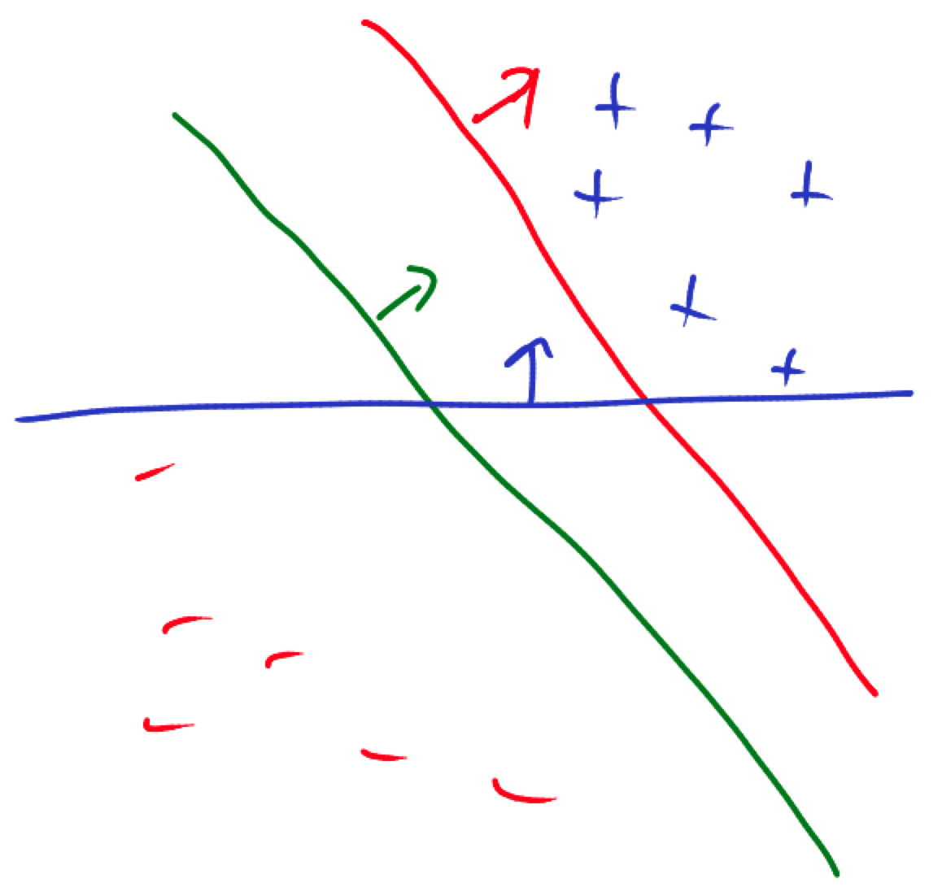
Support Vector Machines (SVM)
Which classifier is the best?
A Course in Machine Learning by Hal Daumé III

Slide 33
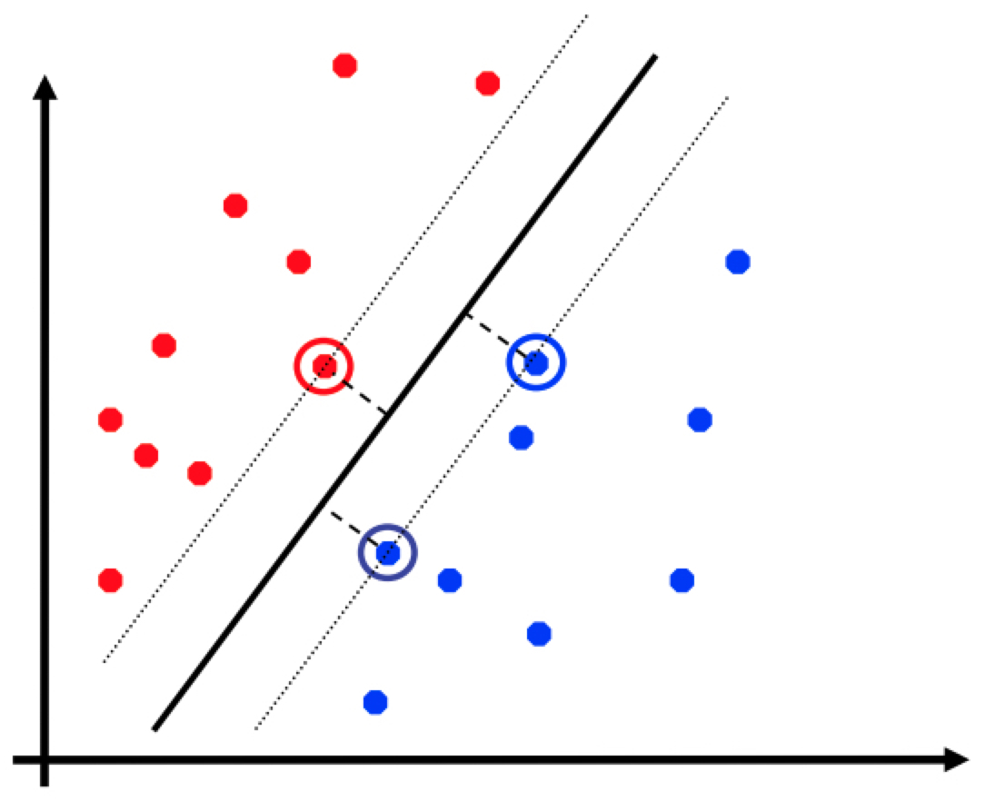
SVM: The Maximum-Margin Principle
classifier
Vapnik (1990) derived the SVM as an “optimal” classifier
Intuitively, robust to outliers
Support vectors: subset of data closest to classifier
Great empirical success in the 90s – early 2000s
margin
David Sontag, NYU ML class

Slide 34
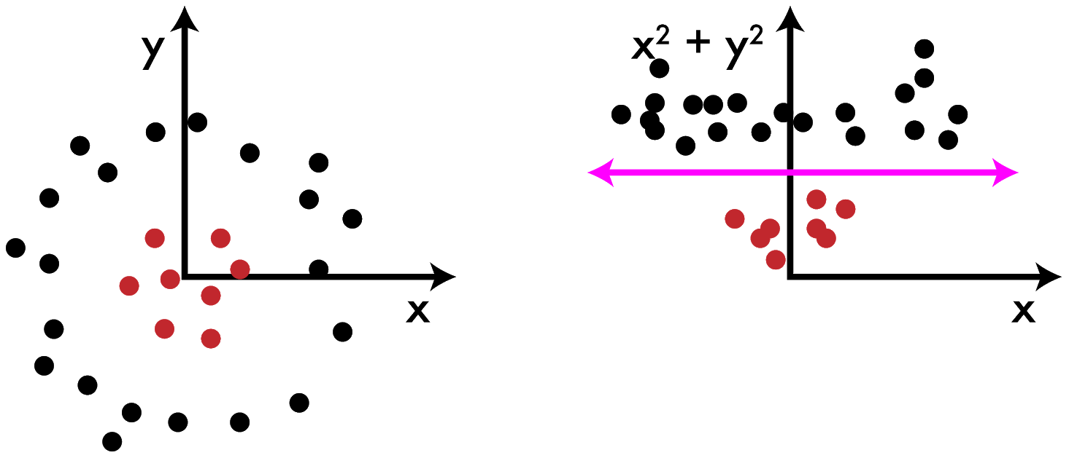
What about non-linearly separable data?
Joseph Redmon, The Ancient Secrets of Computer Vision

Slide 35
SVM for non-linearly separable data
SVM can do this “lifting” at a relatively small additional cost in computation
kernel
Wikipedia SVM article

Slide 36
Final words on SVMs
Advantages
Strong theoretical basis
Easy to train linear SVMs
Typically a strong baseline
Caveats
Non-linear SVM slow to train
Hard to specify a good kernel in advance

Slide 37
Recap
y
ML vs Knowledge-Based AI
The ML mindset
Classification: definition and assumptions
Classifiers:
Decision Trees
Logisitic Regression
Support Vector Machines
x

